Slide 1


StreetReboot1 Kyläsaari depot visit
Data Sources
6Aika: Urban big data as innovation platform in smart city context, A72209.

Slide 2
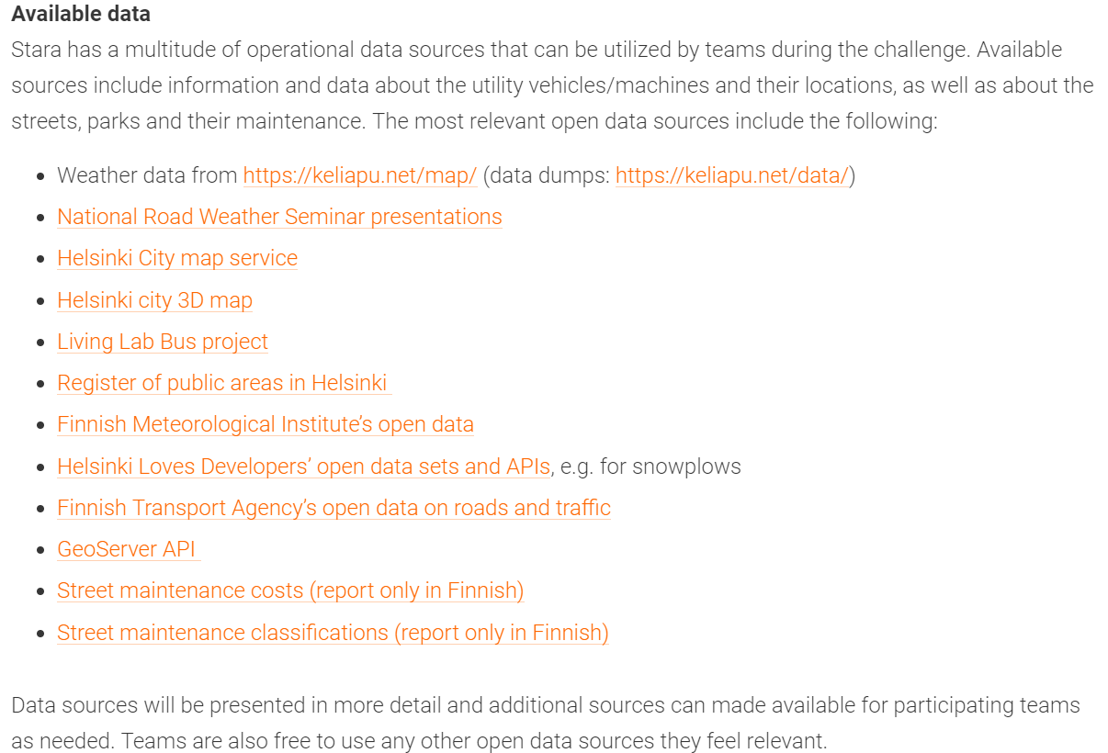
Promised Data Sources

Slide 3
Grouping of the Data available for Hackathon
Hackathon/ Planning and Optimization
SAP: Financial data
Open Data, such as Weather, Traffic, Slipperiness
Machine Registry
GPS-data:
Machine follow-up, Work targets

Slide 4
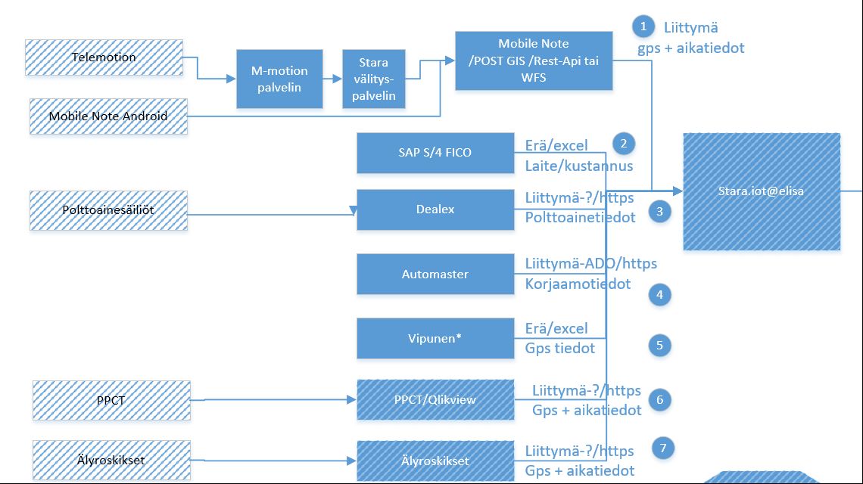
Stara data sources

Slide 5
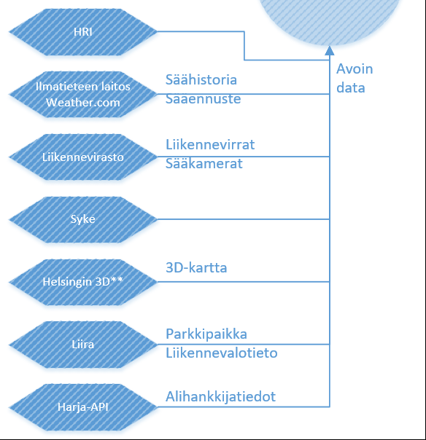
Open Data Sources
6Aika: Urban big data as innovation platform in smart city context, A72209.

Slide 6
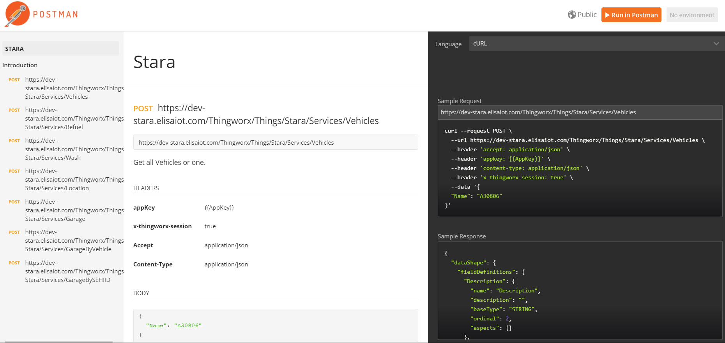
Rest API interface
https://documenter.getpostman.com/view/1976410/stara/6tc44mC

Slide 7
PaikkatietoVipunen
Collections of Location Data of Helsinki
City of Helsinki system including more than 600 data sources
Almost all objects in the city are included
Examples from the streets
Roads, streets, bicycle routes
Waste bins
Parks
Traffic Signs
Look especially YlRe = Yleisten alueiden rekisteri
https://kartta.hel.fi/

Slide 8
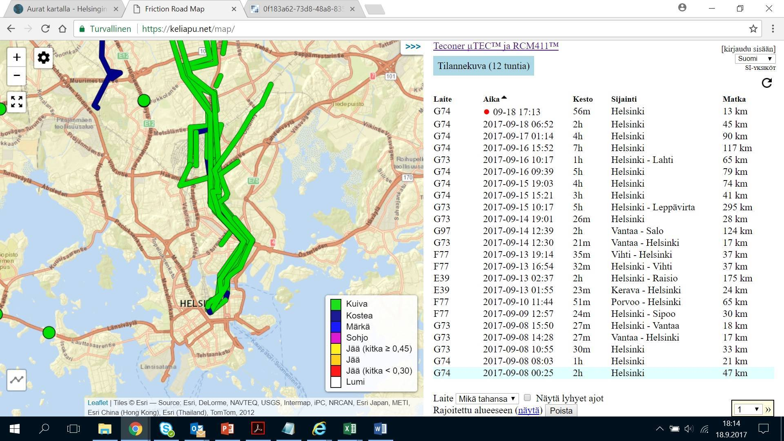
Example of Open Data
Laite G74, G73, F34, G97, E39, G84, F77
https://keliapu.net/map/
data dumpit täältä https://keliapu.net/data/

Slide 9
Data Support during Hackathon
Skype for Business discussion on next Monday or Wednesday with every team 15-30 minutes
Slack
Skype for Business support as necessary
Phone support as necessary
Requests via
Ensio Ruotsalainen
Ensio.ruotsalainen@professa.fi
040 3529190

